Slide 1
PROJECT REVIEW
On
FORECASTING STORE SALES USING R
for the requirements of
“BUSINESS ANALYTICS WITH R”
Under the Guidance
Prof. Soumyajyoti Datta
Amit Behura (UM19139) | Amrit Anand Mahapatra (UM19141) | Devansh Jajodia (UM19151) | Gudimella Bhargav Kiran ( UM19153) | Manjeet Khandayatray (UM19162)
Group 4, BAR - Section II, MBA-BM (2019-21)
Xavier Institute of Management, Bhubaneswar

Slide 2
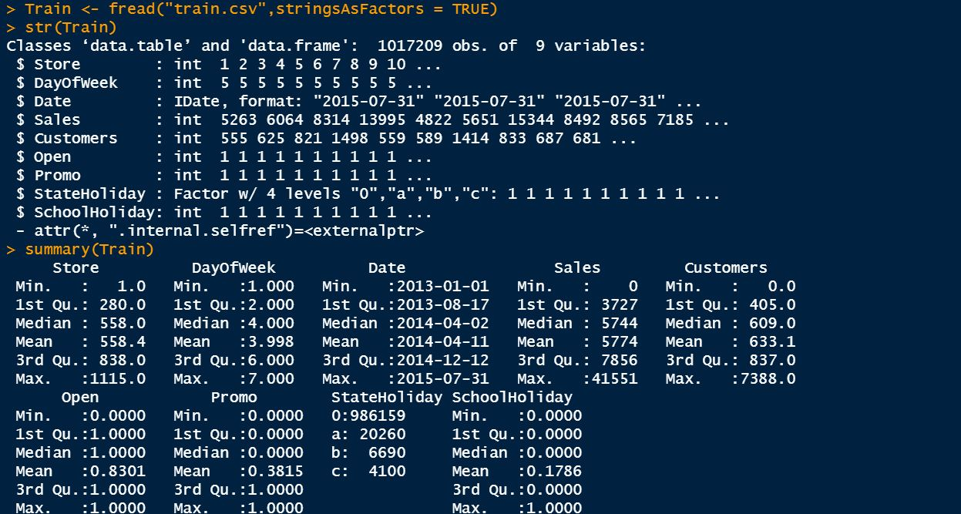
Experimental Dataset
Experimental/Training Date for Sales of Healthcare products obtained for 2 years, as obtained from Kaggle.com

Slide 3
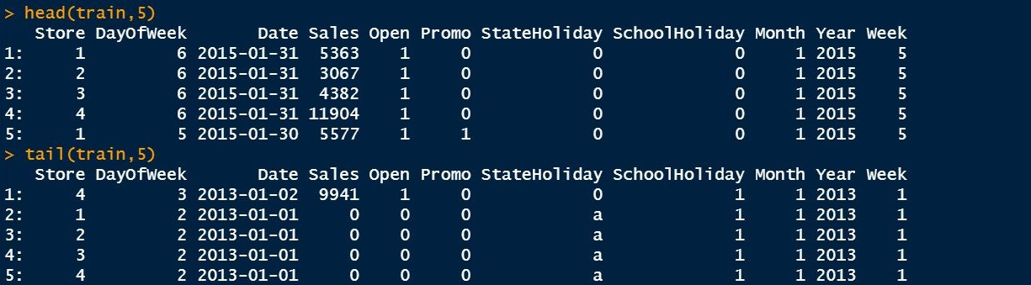
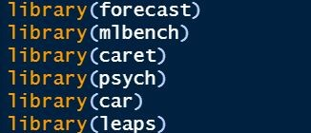
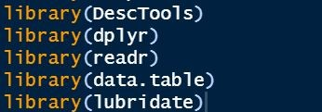
Experimental Dataset
The original data set has around 10 Lakh Sales Observations from 1st January 2013 to 31st January 2015.
There are no NA values.
However the date format is inaacurate which has to be modified.

Slide 4
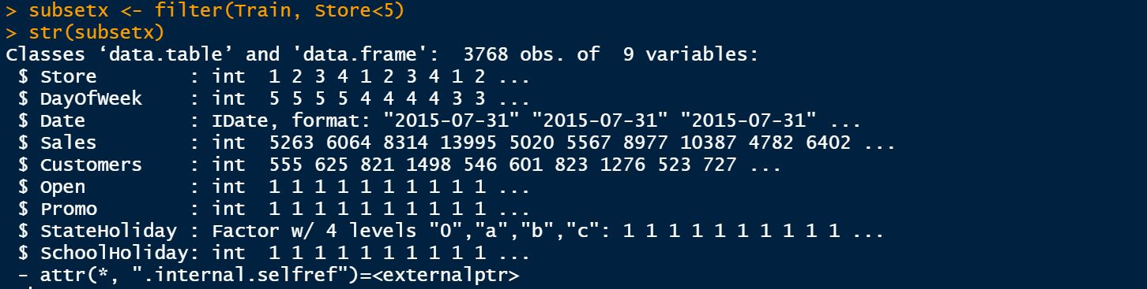
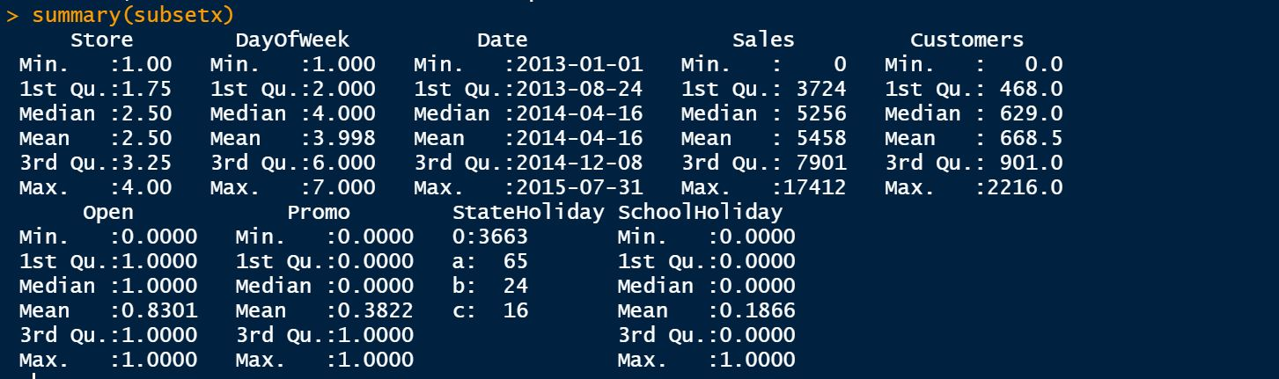
Filtered Dataset
Owing to the limitation of System Requirements, we took a sample of the entire data set where the store is count is upto 4, so that we have only 3768 observations in 9 variables.
The format of the date is to converted into the Date Format

Slide 5
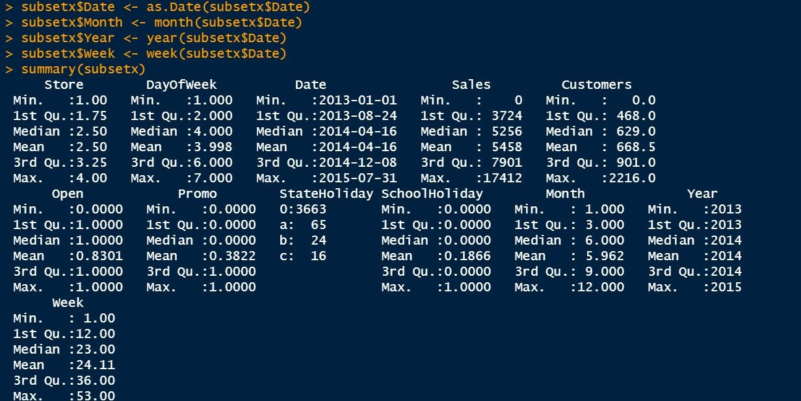
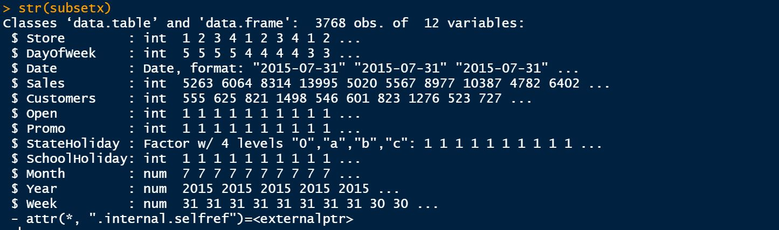
The format of date in the dataset is now changed to “date” as shown by str(subset) command in the closet.

Slide 6
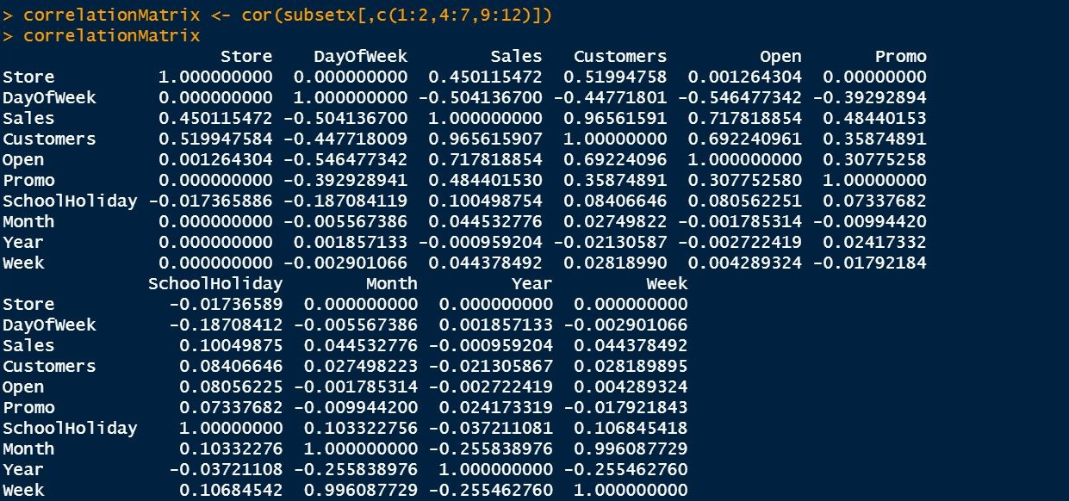
Correlation Matrix
The Column Variables 1,2,4,5,6,7,9,10,11 & 12 are taken.
The 3rd column which was “date” has been dropped due to non numeric datatype.
The 8th Column “State Holidays” are included also as School Holiday, hence dropped due to multiple co-relationship. It is also in factor format.

Slide 7
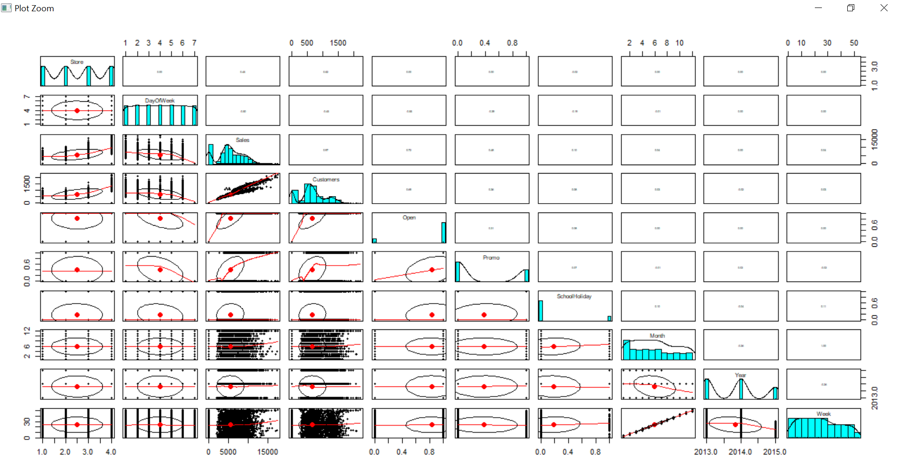
The Correlation between Sales & Customers is 0.97 but the no. of customers cannot be an independent variable quantity and therefore cannot be forecasted.
Correlation Matrix
The Correlation between Month and Week Sales is 1 which can be used for Sales Forecasting

Slide 8
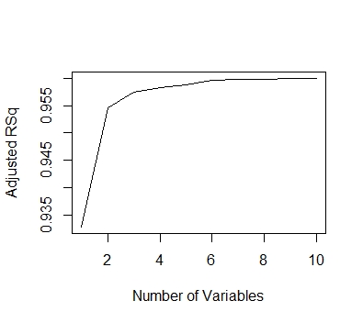
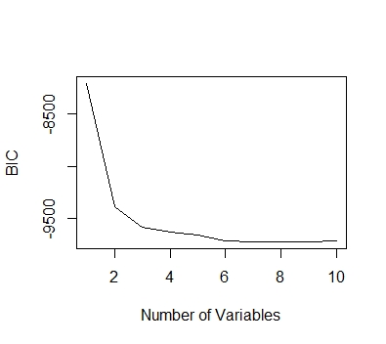
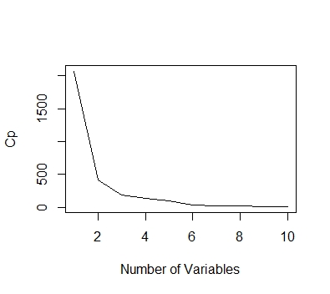
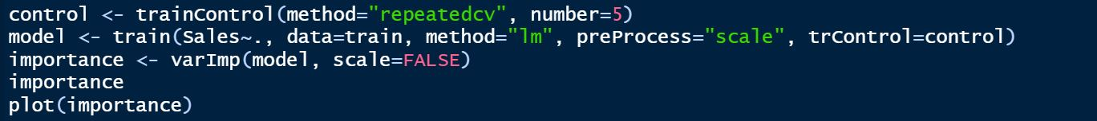
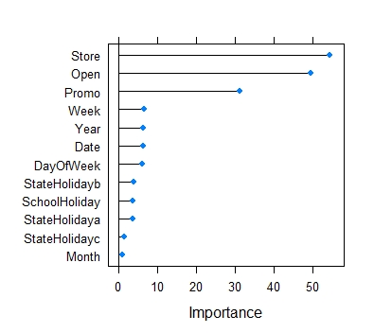
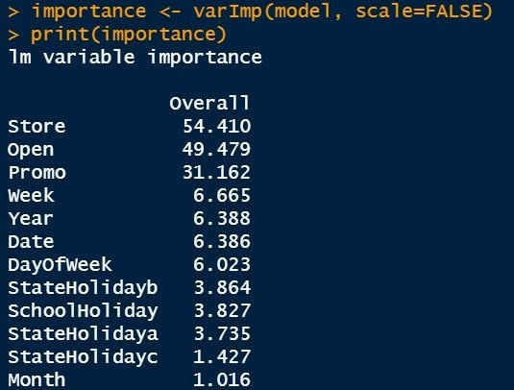
Correlation Matrix
Using Adjusted R Square, BIC and CP method we could see that there is the requirement of atleast 9 variables in BIC and 10 Variables in Adjusted R Square as the varibales of analysis.

Slide 9
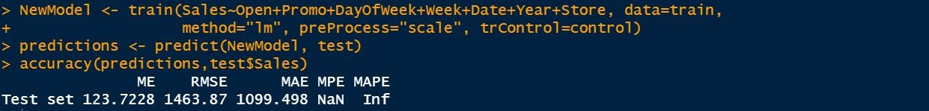
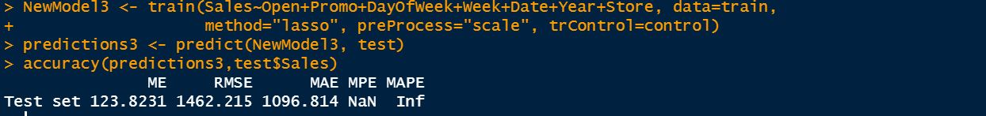
Regression Models
From this table we could find that Penalized Regression method has the least RMSE as well as least MAE. All the methods have an infinite MAPE value as there are stores with ZERO Sales value on holidays.
Linear Regression Model
Penalized Regression Model
Lasso Regression Model
 | ME | RMSE | MAE | MPE | MAPE
method="lm" | 123.7228 | 1463.87 | 1099.498 | NaN | Inf
method="penalized" | 124.3421 | 1461.546 | 1089.053 | NaN | Inf
method="lasso" | 123.8231 | 1462.215 | 1096.814 | NaN | Inf

Slide 10
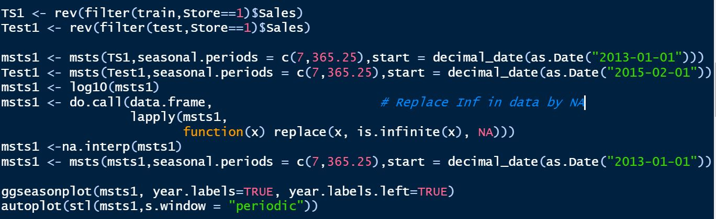
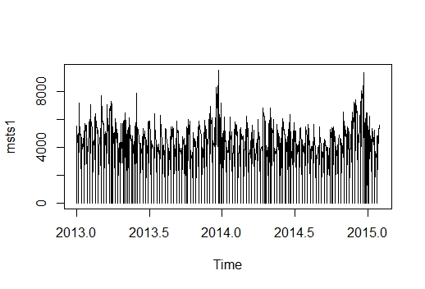
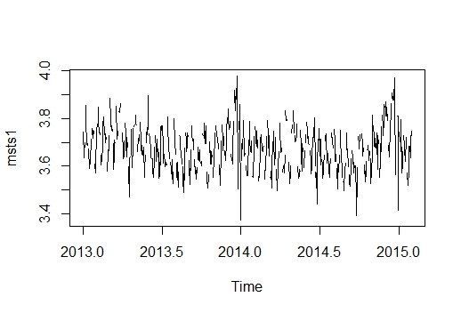
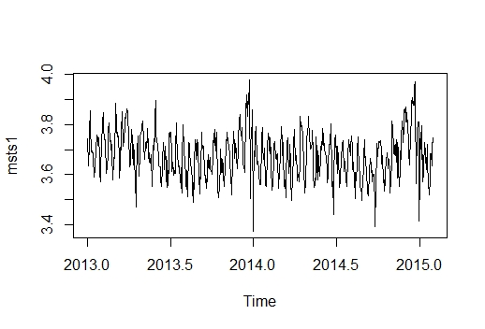
Time Series Analysis

Slide 11
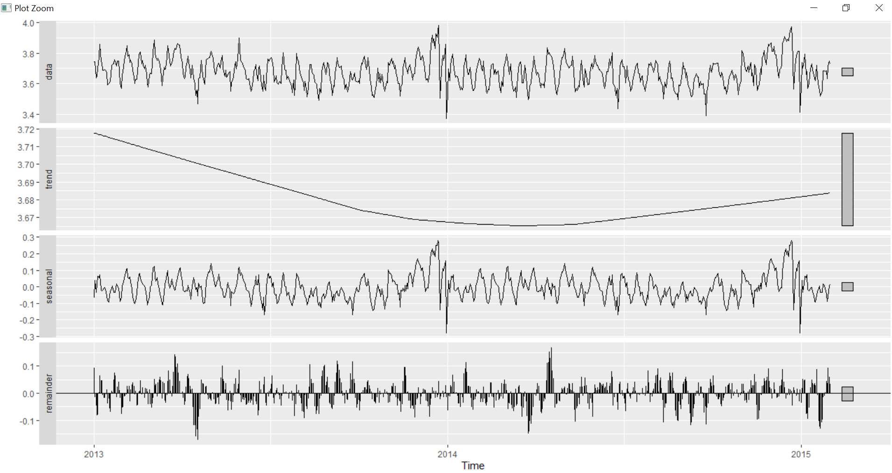
Seasonal Forecasting
Seasonal Decomposition of Time Series

Slide 12
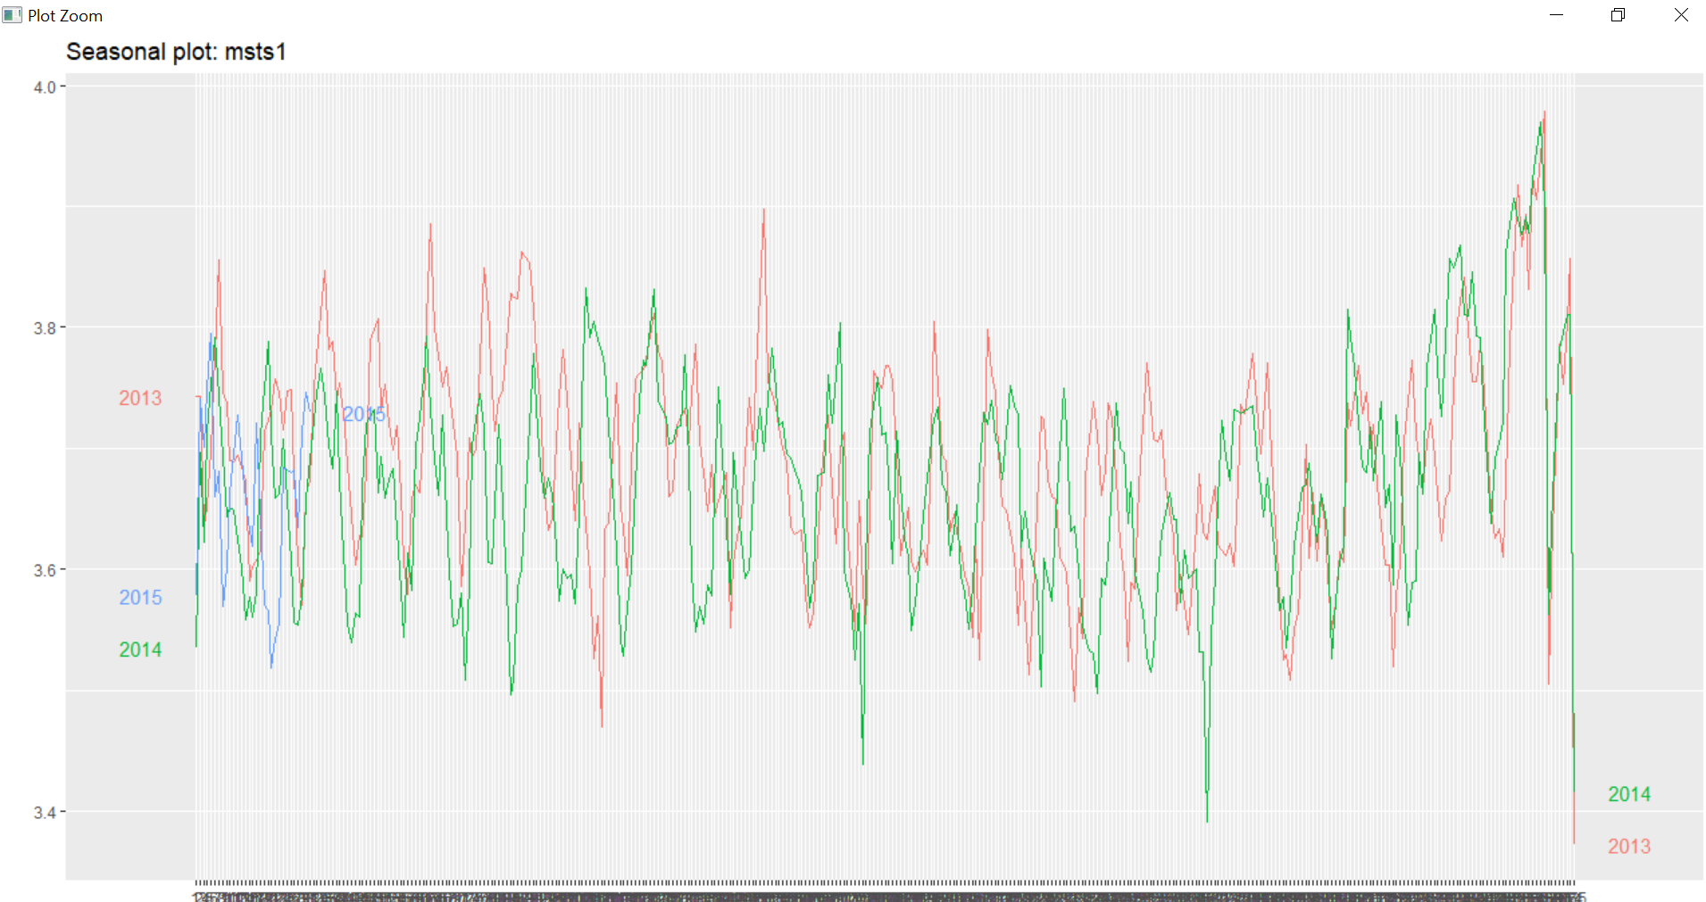
Seasonal Forecasting

Slide 13
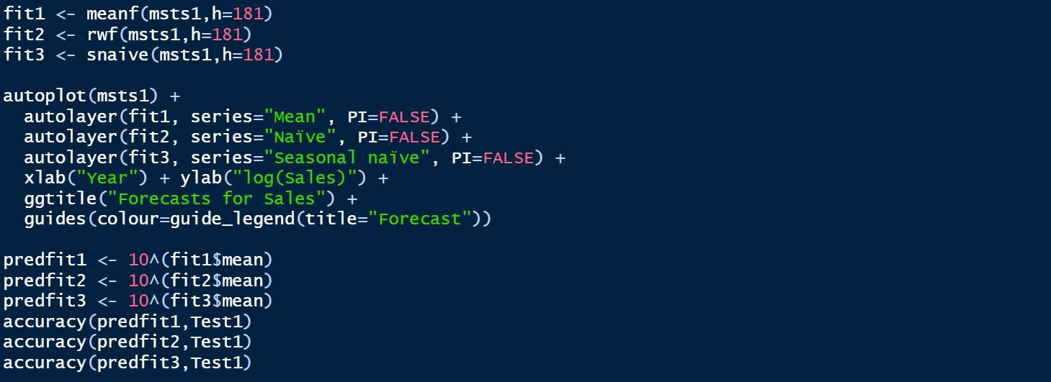
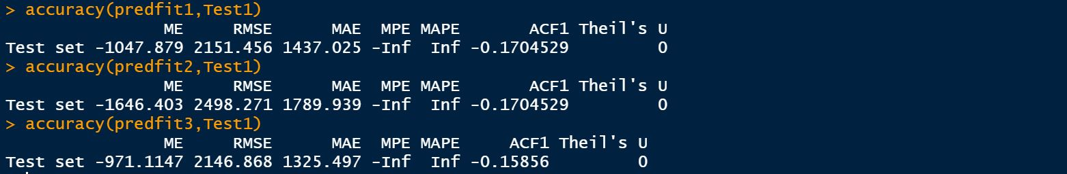
Benchmarking Time Series Forecasting
BASIC FORECASTING METHODS
Mean Average Forecasting – Predicting based on the Mean of the Previous Data
Naïve Forecasting - Predicting based on the last value obtained
Seasonal Forecasting – Follows the Seasonal variation of the last period along the mean obtained.
h = 181 represents the horizon for forecasting, in our case we have made the forecast from 01/02/2015 to 31/07/2015, for a period of 6 months,

Slide 14
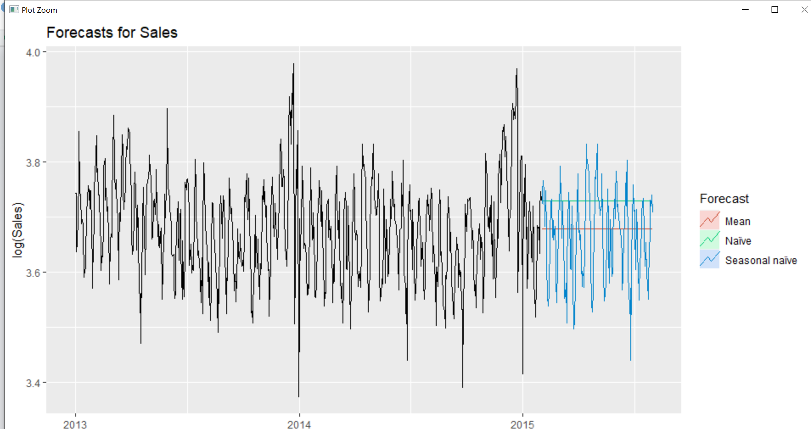
Benchmarking Forecasting

Slide 15
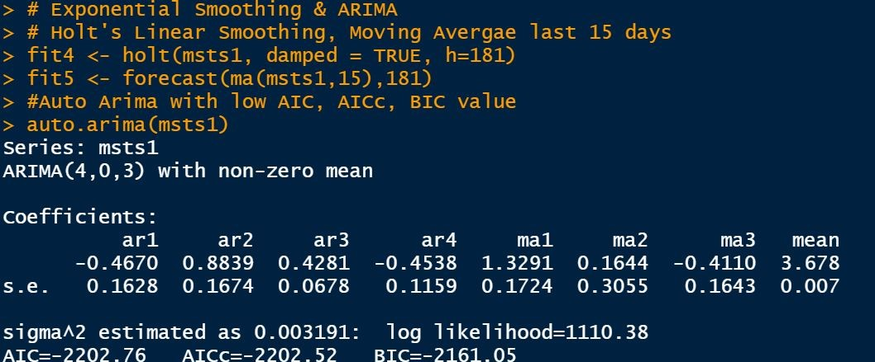
Exponential Smoothing, Moving Average Forecasting

Slide 16
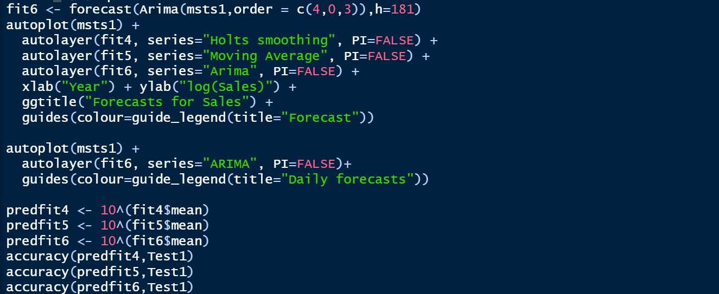
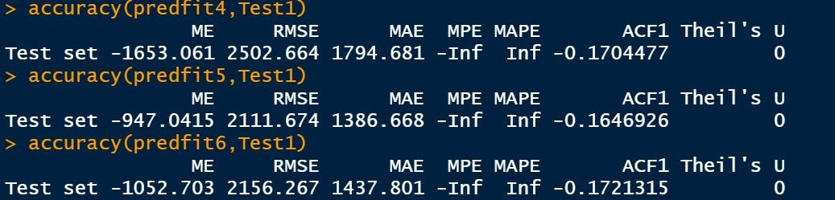
Arima Forecasting

Slide 17
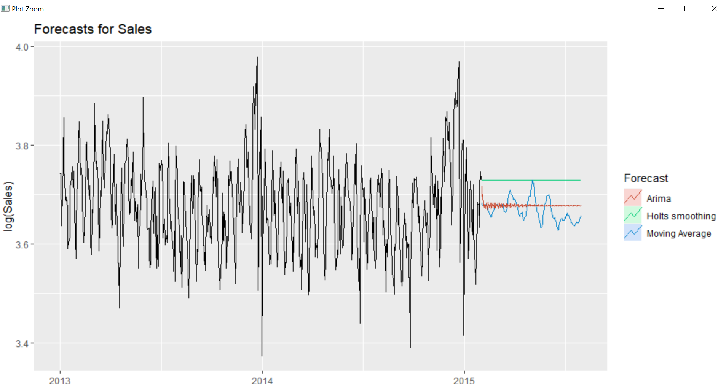
ARIMA Forecasting

Slide 18
Conclusion
 |  |  | Forecasting Method | ME | RMSE | MAE | MPE | MAPE
 | Regression Models |  | method="lm" | 123.7228 | 1463.87 | 1099.498 | NaN | Inf
 |  |  | method="penalized" | 124.3421 | 1461.546 | 1089.053 | NaN | Inf
 |  |  | method="lasso" | 123.8231 | 1462.215 | 1096.814 | NaN | Inf
1 | Time Series Models | Fit 1 | Mean Average | -1047.879 | 2151.456 | 1437.025 | -Inf | Inf
2 |  | Fit 2 | Naïve | -1646.403 | 2498.271 | 1789.939 | -Inf | Inf
3 |  | Fit 3 | Seasonal Naive | -971.1147 | 2146.868 | 1325.497 | -Inf | Inf
4 |  | Fit 4 | Exponential Smoothing | -1653.061 | 2502.664 | 1794.681 | -Inf | Inf
5 |  | Fit 5 | Moving Average | -947.0415 | 2111.674 | 1386.668 | -Inf | Inf
6 |  | Fit 6 | Arima | -1052.703 | 2156.267 | 1437.801 | -Inf | Inf

Slide 19
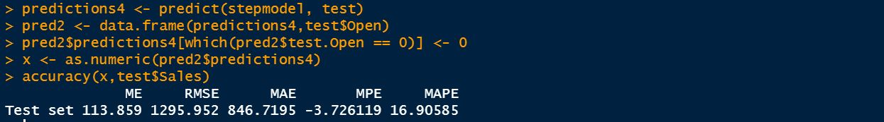
Analysed Step Model
For the stores we selected a variable “OPEN”
The store is open -> OPEN = 1
The store is closed-> OPEN = 0
Whenever the store is closed, the sales value are made as ZERO.

Slide 20
Business Implications
The pharmaceutical supply chain is highly complex and the demand is highly uncertain.
Demand is influenced by a numerous external variables. For eg, patients length of treatment and air quality and hygiene in the surroundings.
Due to these multitude of factors, players in this industry adopt easier methods like naive and moving average for forecasts.
In our study, of all the models, regression based forecasting model provides the best fitting curve to the historical train data with lower error estimates and higher accurate demand estimation.
We suggest weekly forecasts in place of daily forecasts because the frequency of forecasting will reduce from 365.25 to 52 which will help in accommodating a better model in R.
Weekly forecasts will save the money, time and efforts and they also increase the forecasting accuracy by aggregation. Considering the shelf life of the medicines, Reorder points can be scaled up through aggregate weekly forecasts resulting in saving ordering costs.

Slide 21
THANK YOU

